Slide 2
Outline
Introduction
Motivation
Study area and forcing mechanisms
Methodology
Numerical model
Model setup
Hindcast approach
Results
Model validation
SC contribution to the flow
Effects on plume dispersion
www.metocean.co.nz

Slide 3
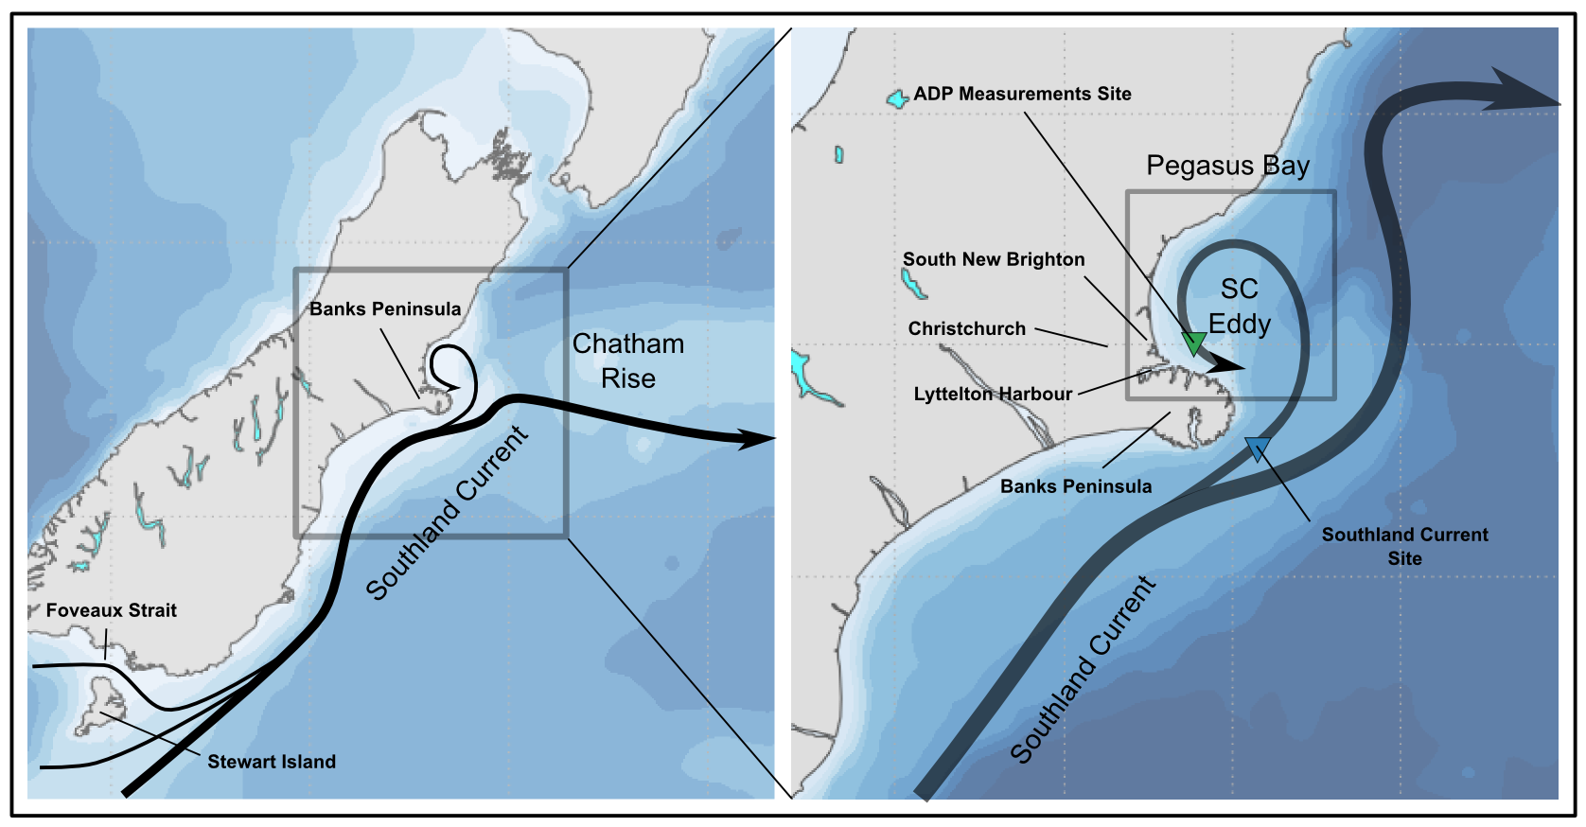
Motivation
According to Chiswell (1996) and Reynolds-Flemming et al. (2005)
www.metocean.co.nz

Slide 4
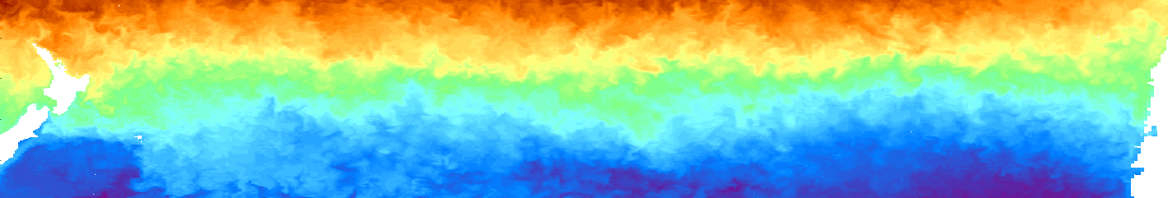
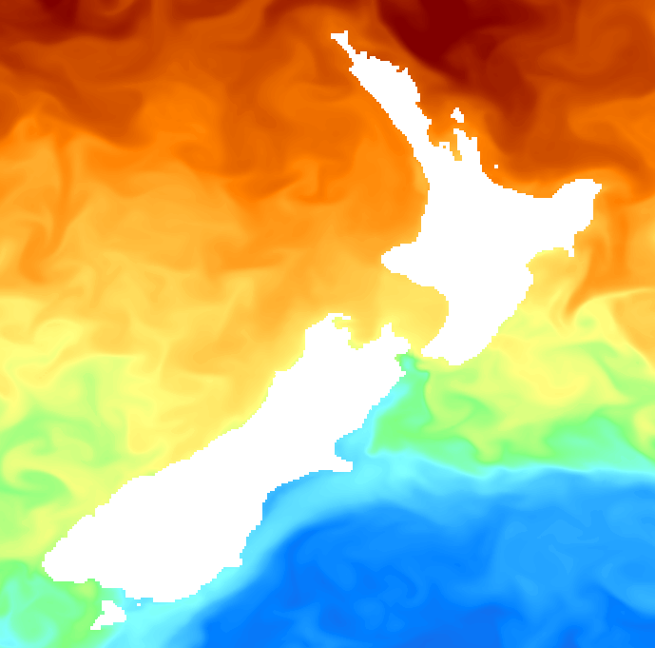
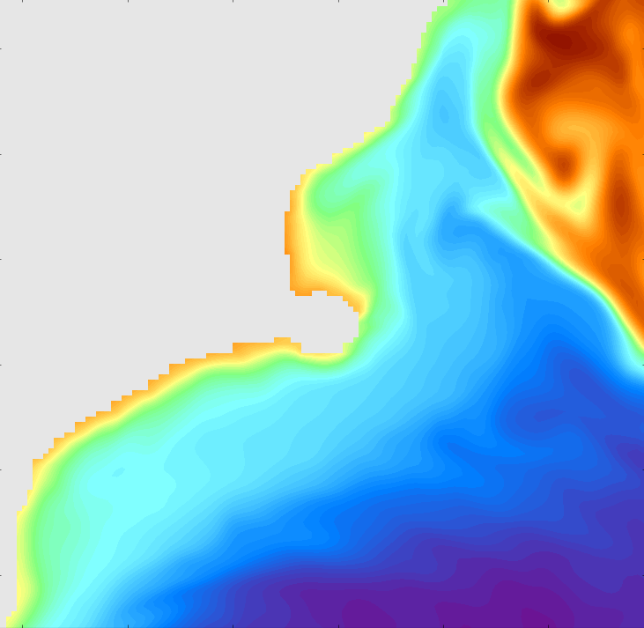
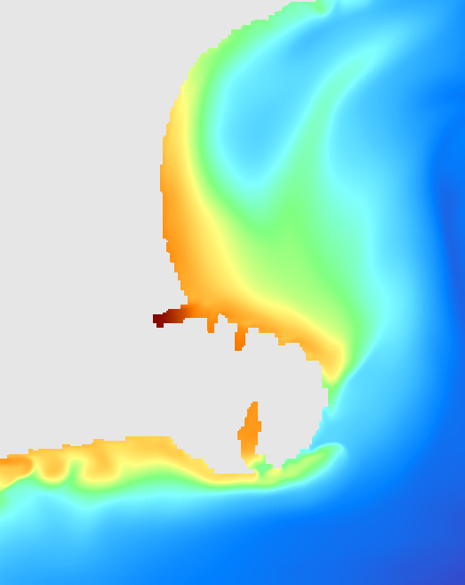
Overview of the forcing mechanisms
NZ
Rossby Waves: ~10-30 days, ~100-200 km
Chile
Eddies + topography +
Local BC instabilities
Southland current eddy
Winds
Coastal jets and waves
Frontal structures
Tides
Winds
100 km
100 km
Rossby Waves
Southland Current
www.metocean.co.nz

Slide 5
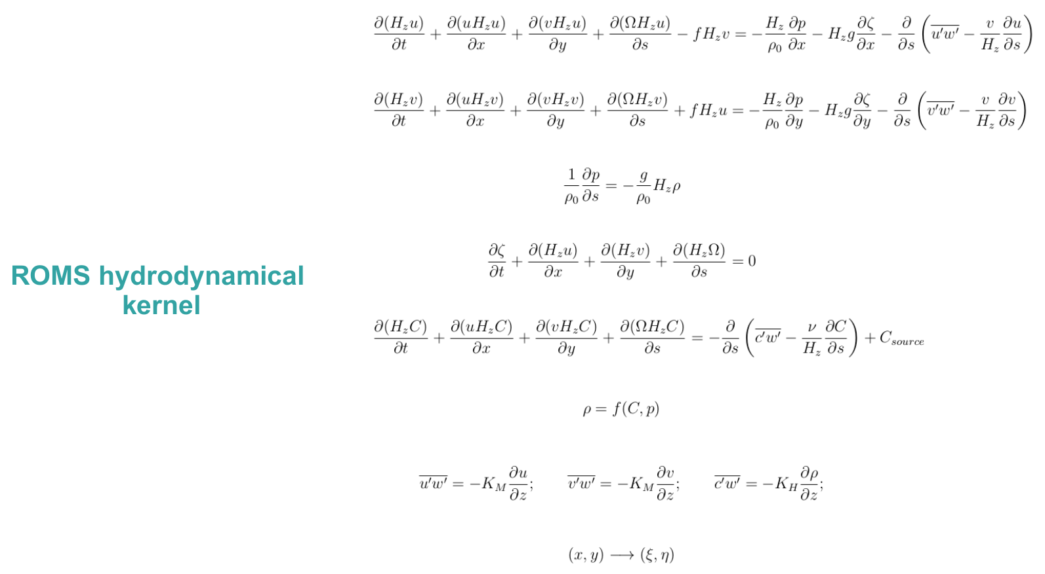
Numerical Model
Haidvogel et al. (2008)
www.metocean.co.nz

Slide 6
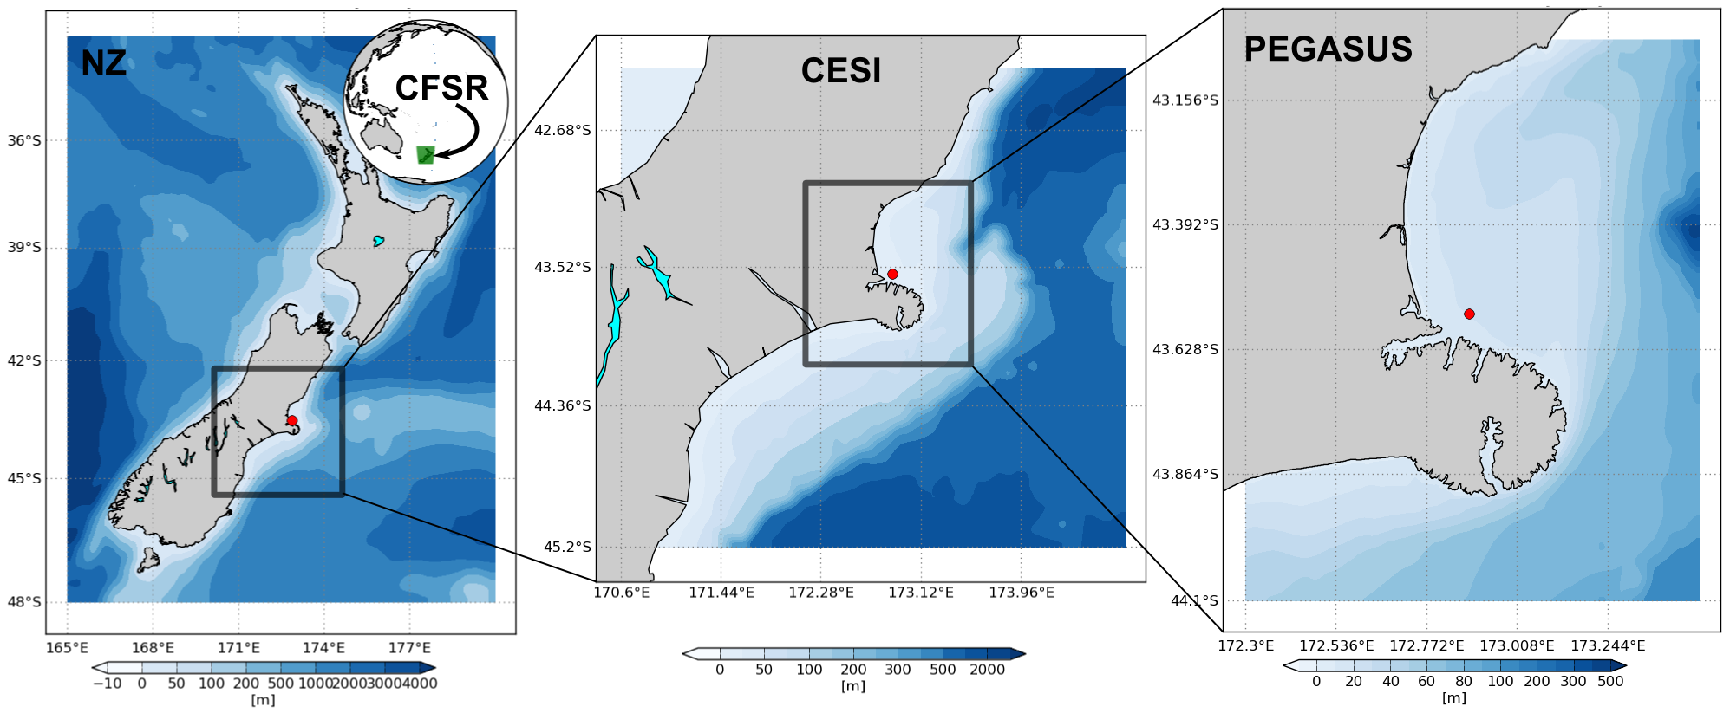
Model setup
www.metocean.co.nz

Slide 7
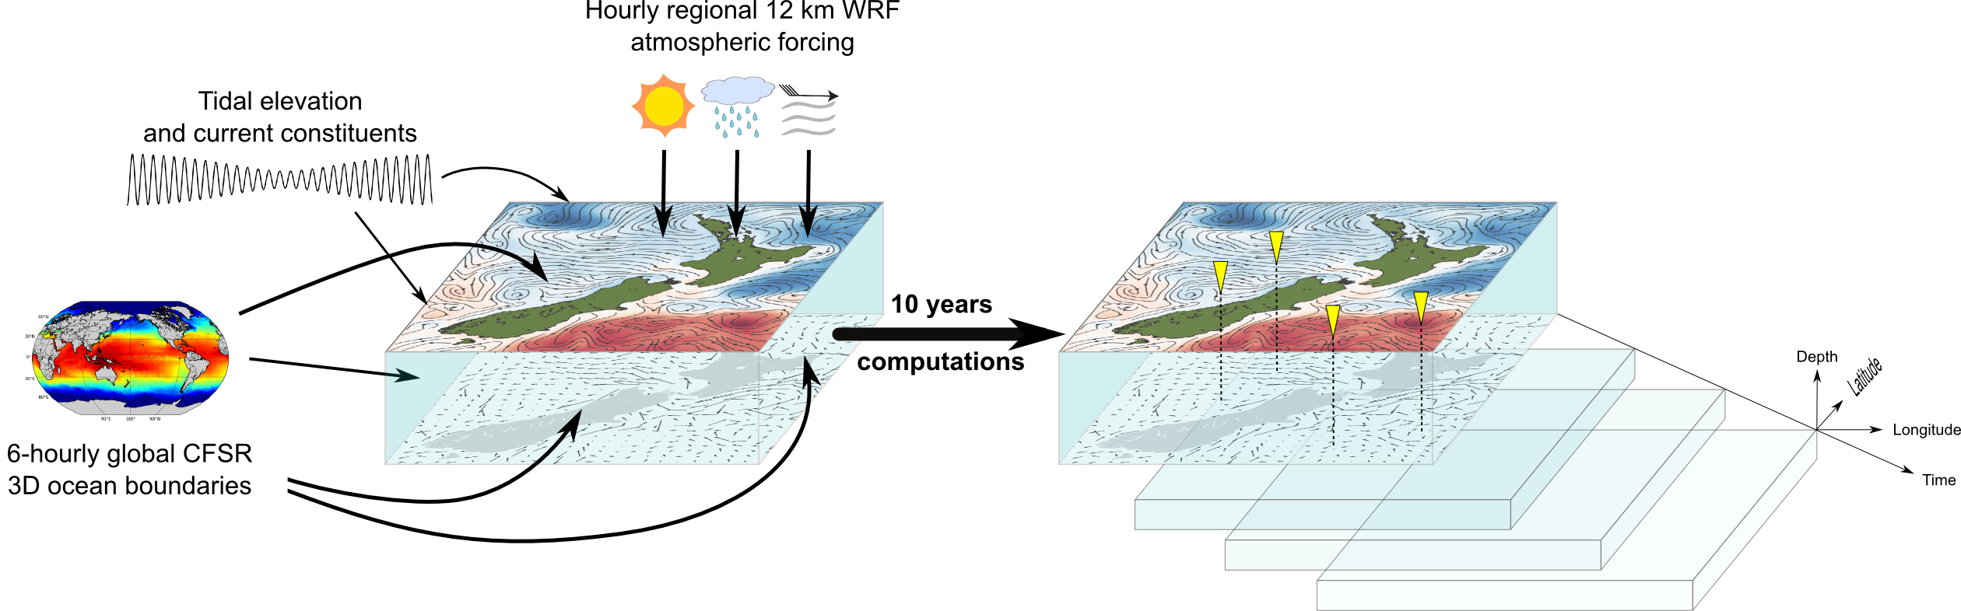
Hindcast approach
www.metocean.co.nz

Slide 8
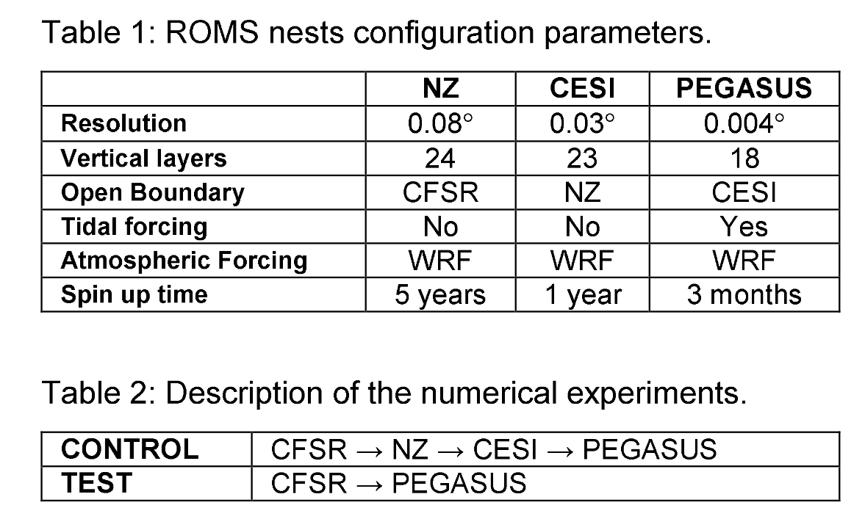
Investigation approach
www.metocean.co.nz

Slide 9
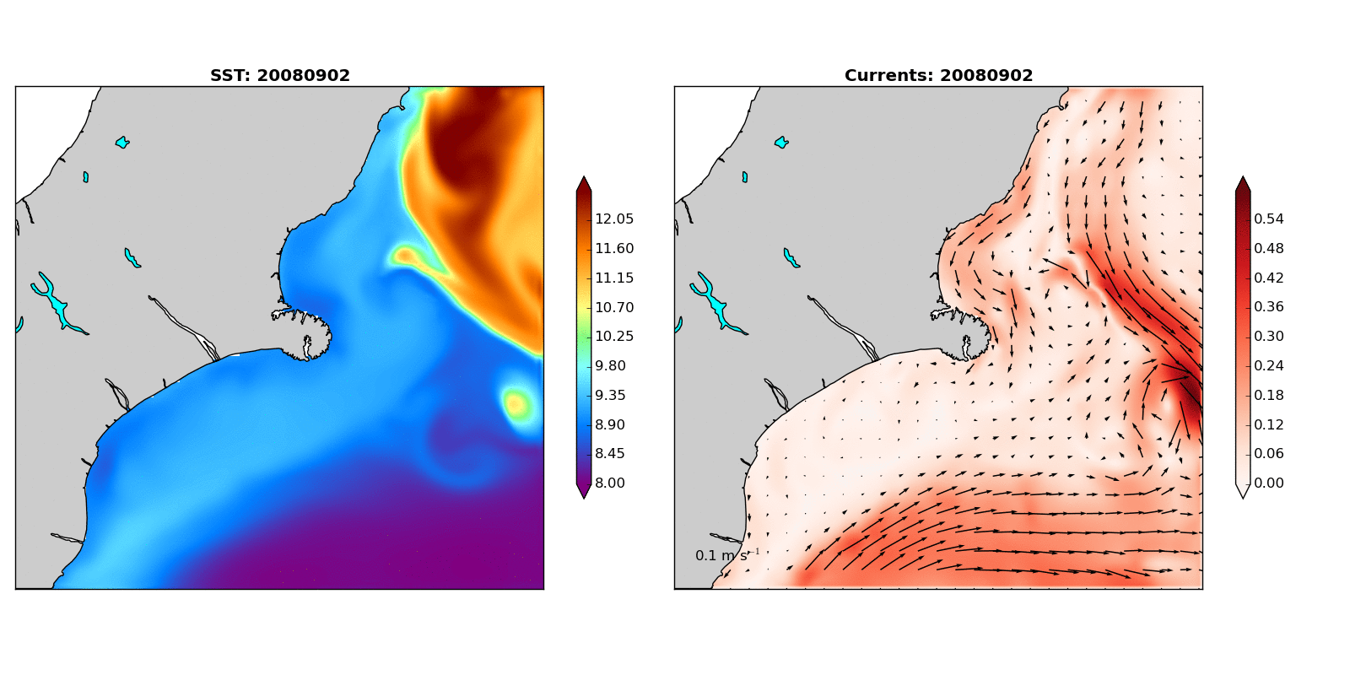
Results
www.metocean.co.nz

Slide 10
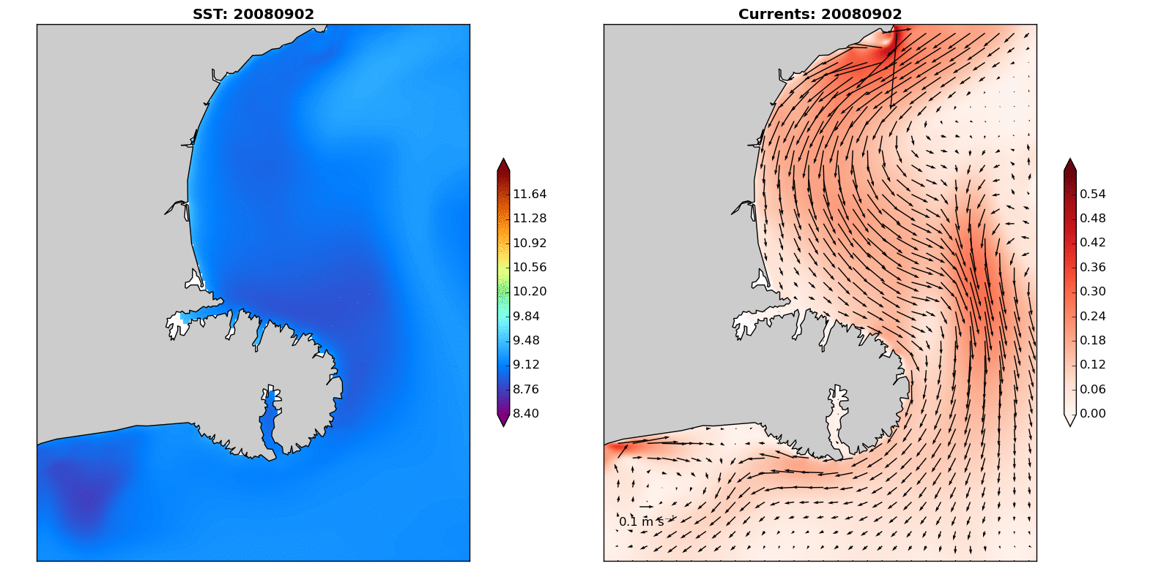
Results
www.metocean.co.nz

Slide 11
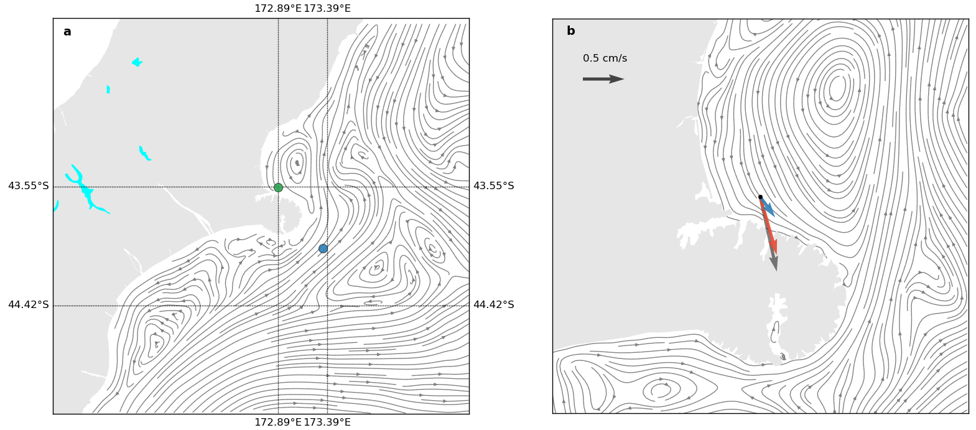
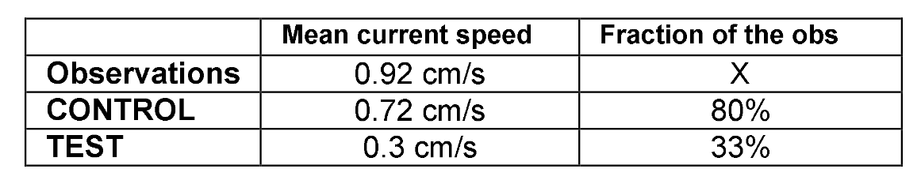
Results – average flow
www.metocean.co.nz

Slide 12
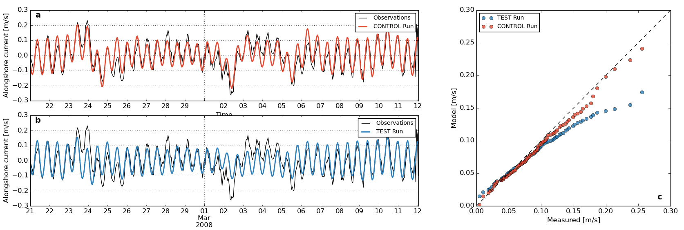
Results – model validation
www.metocean.co.nz

Slide 13
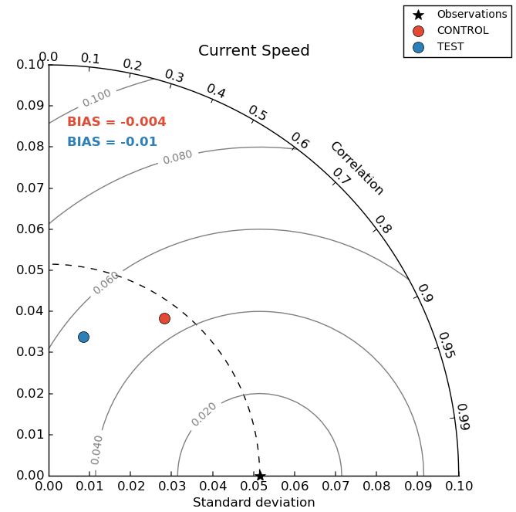
Results – model validation
www.metocean.co.nz

Slide 14
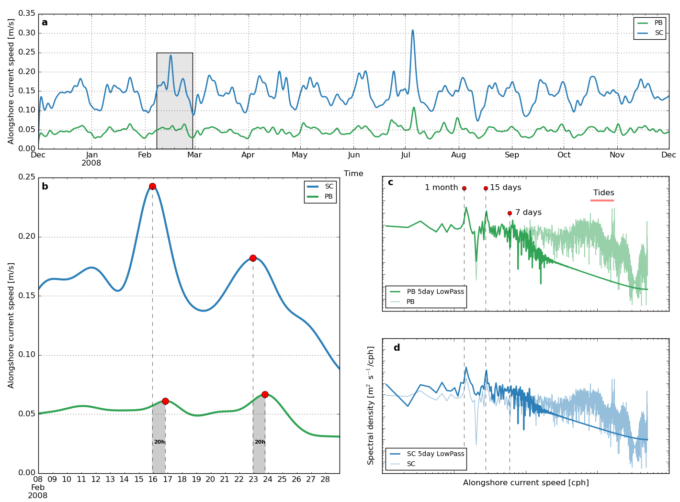
Results – along-shore flow analysis
www.metocean.co.nz

Slide 15
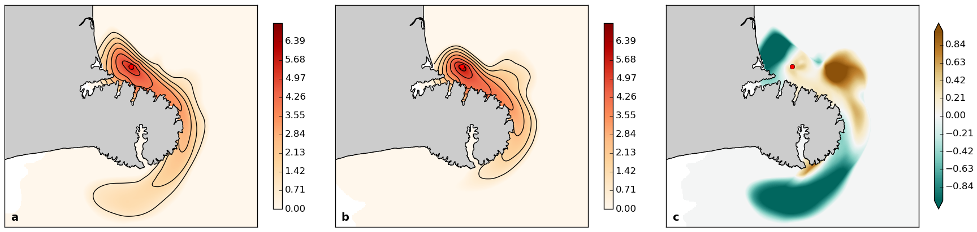
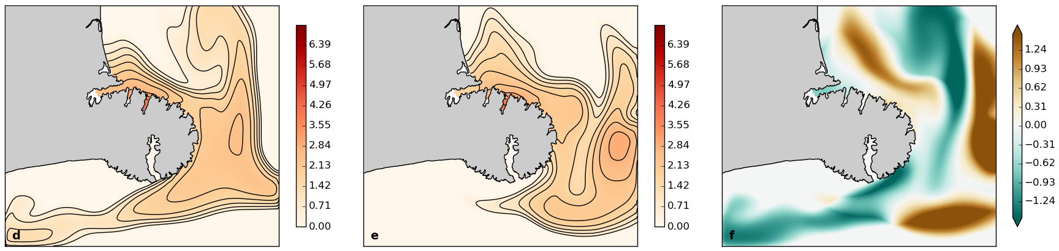
Results – potential effects on plume dispersion
www.metocean.co.nz

Slide 16
Final Remarks
www.metocean.co.nz

